Slide 1

Outline
Learning Aesthetics from Social Media Data
Go beyond affective computing
Yihui Ma
2018.08.02

Slide 2
Motivation
Aesthetic appreciation capacity is another emotional factor in artificial intelligence.
For people, we describe aesthetics by adjectives like formal, casual, romantic…
However, for computers, they recognize the things and describe the aesthetics by visual features in the beginning.
So how can we make computers learn to appreciate the aesthetics? The key task is to bridge the gap between visual features and aesthetic words.

Slide 3
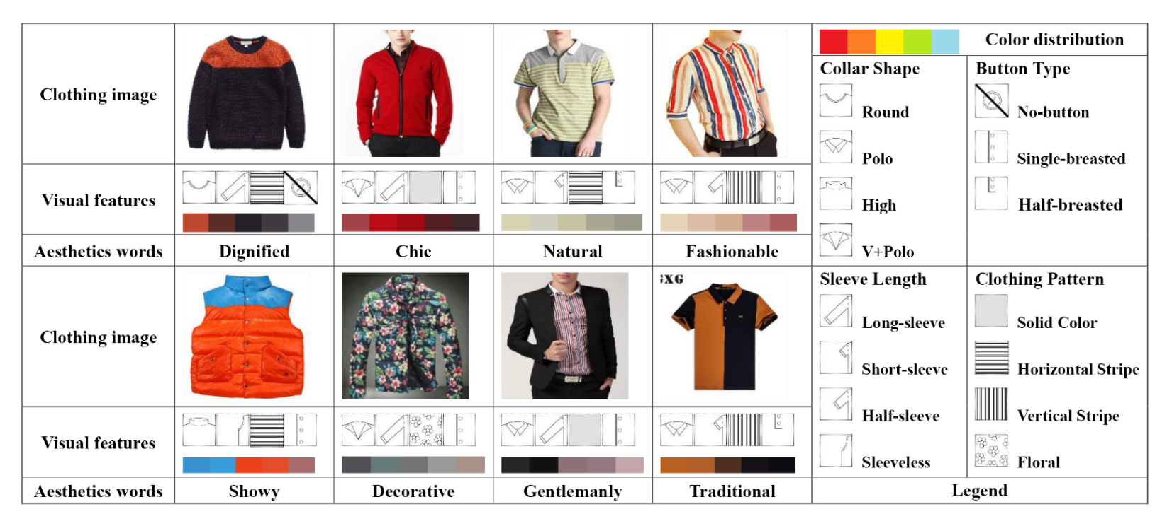
Learning to Appreciate the Aesthetic Effects of Clothing
Jia Jia, etc,. Learning to Appreciate the Aesthetic Effects of Clothing, AAAI 2016

Slide 4
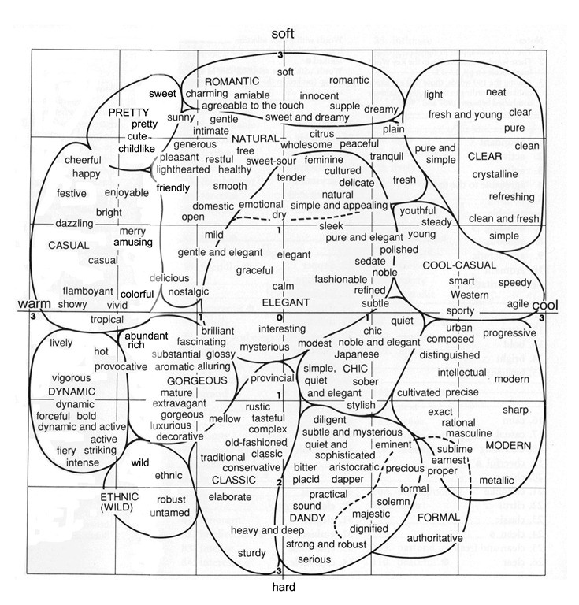
Learning to Appreciate the Aesthetic Effects of Clothing
Jia Jia, etc,. Learning to Appreciate the Aesthetic Effects of Clothing, AAAI 2016

Slide 5
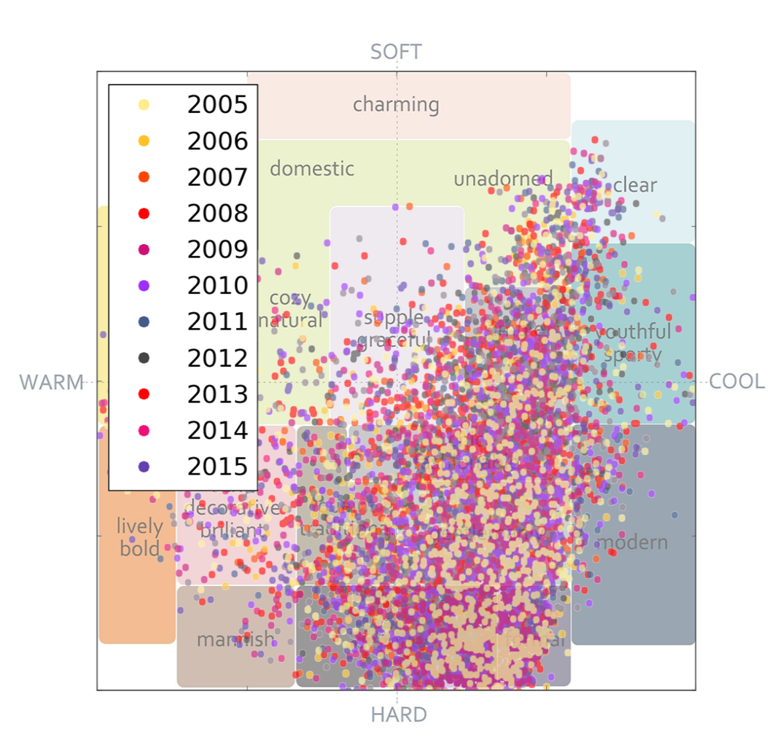
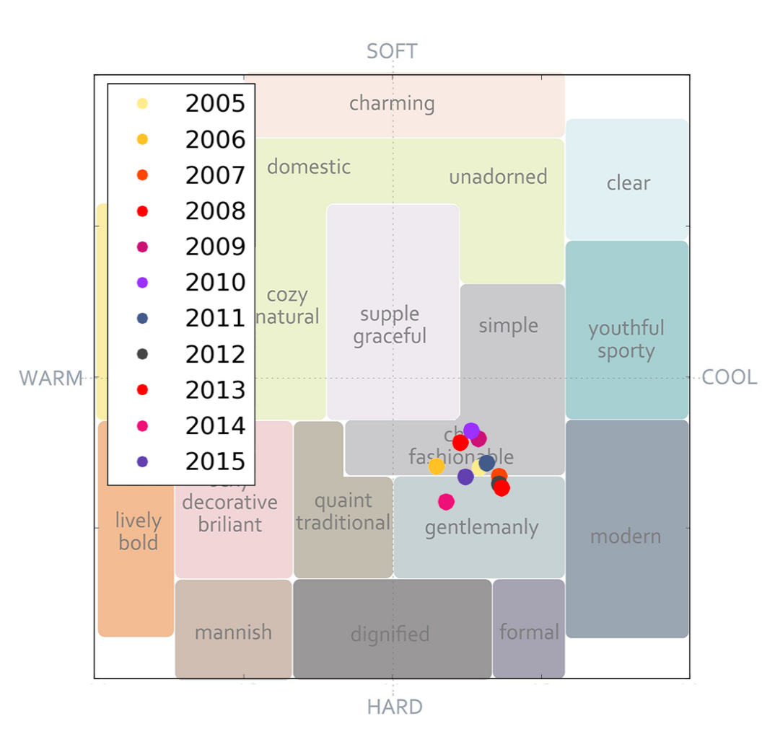
Learning to Appreciate the Aesthetic Effects of Clothing
Jia Jia, etc,. Learning to Appreciate the Aesthetic Effects of Clothing, AAAI 2016

Slide 6
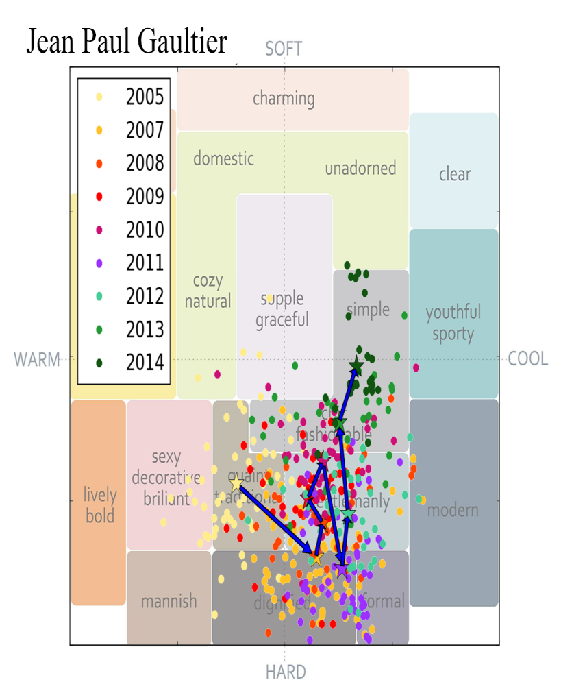
Learning to Appreciate the Aesthetic Effects of Clothing
Jia Jia, etc,. Learning to Appreciate the Aesthetic Effects of Clothing, AAAI 2016

Slide 7
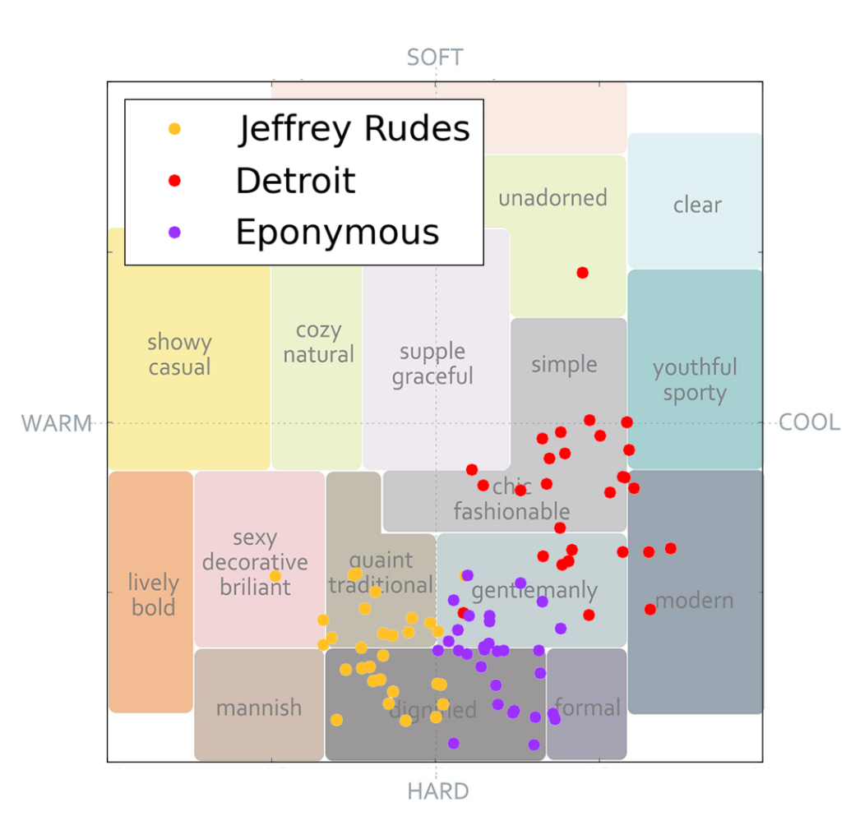
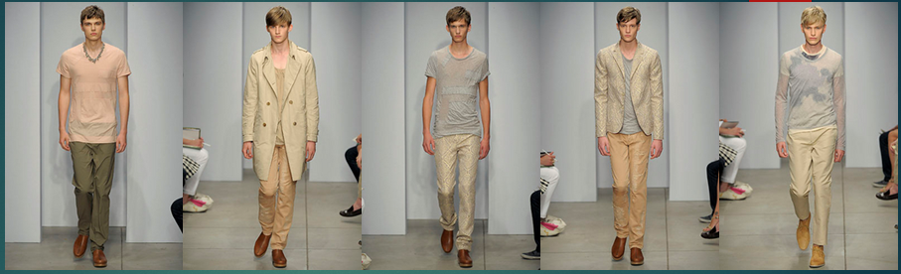
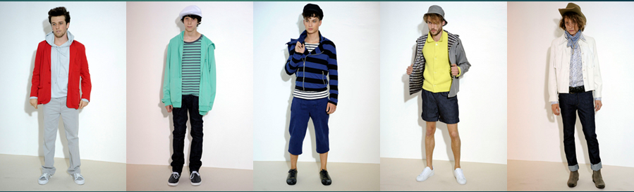
Learning to Appreciate the Aesthetic Effects of Clothing
Jia Jia, etc,. Learning to Appreciate the Aesthetic Effects of Clothing, AAAI 2016

Slide 8
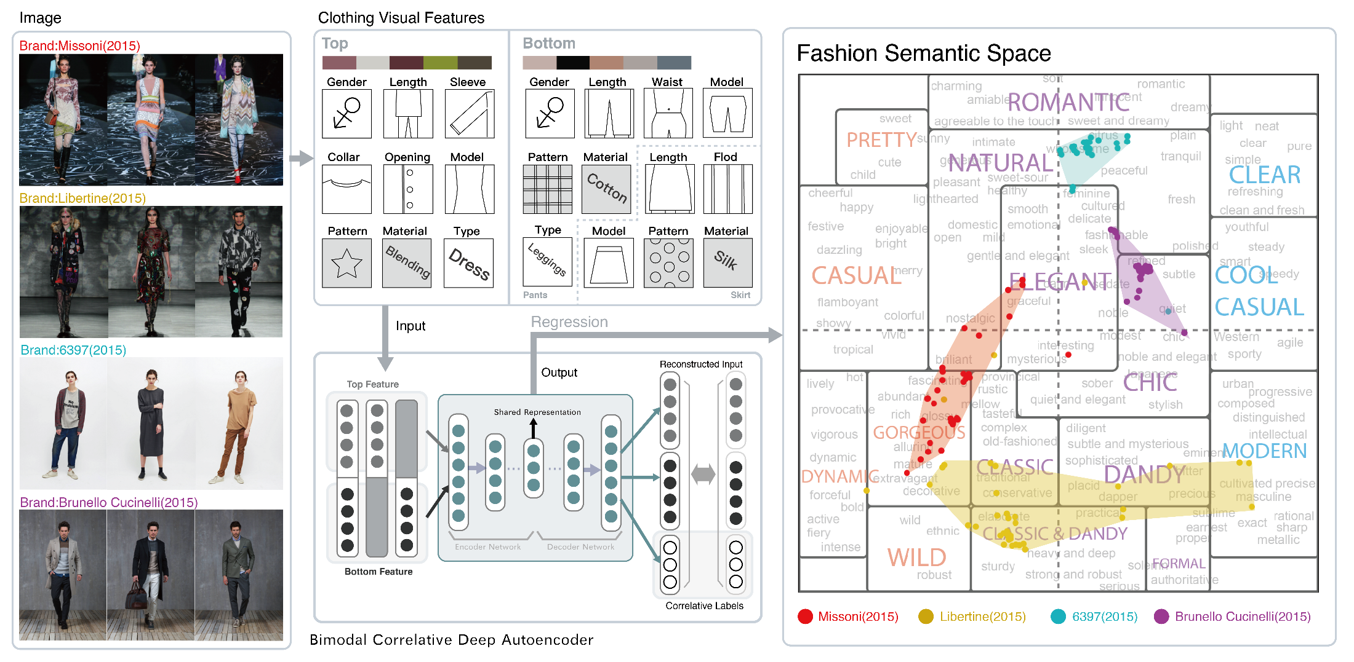
Towards Better Understanding the Clothing Fashion Styles: A Multimodal Deep Learning Approach
Yihui Ma, Jia Jia, etc., Towards Better Understanding the Clothing Fashion Styles: A Multimodal Deep Learning Approach, AAAI 2017

Slide 9
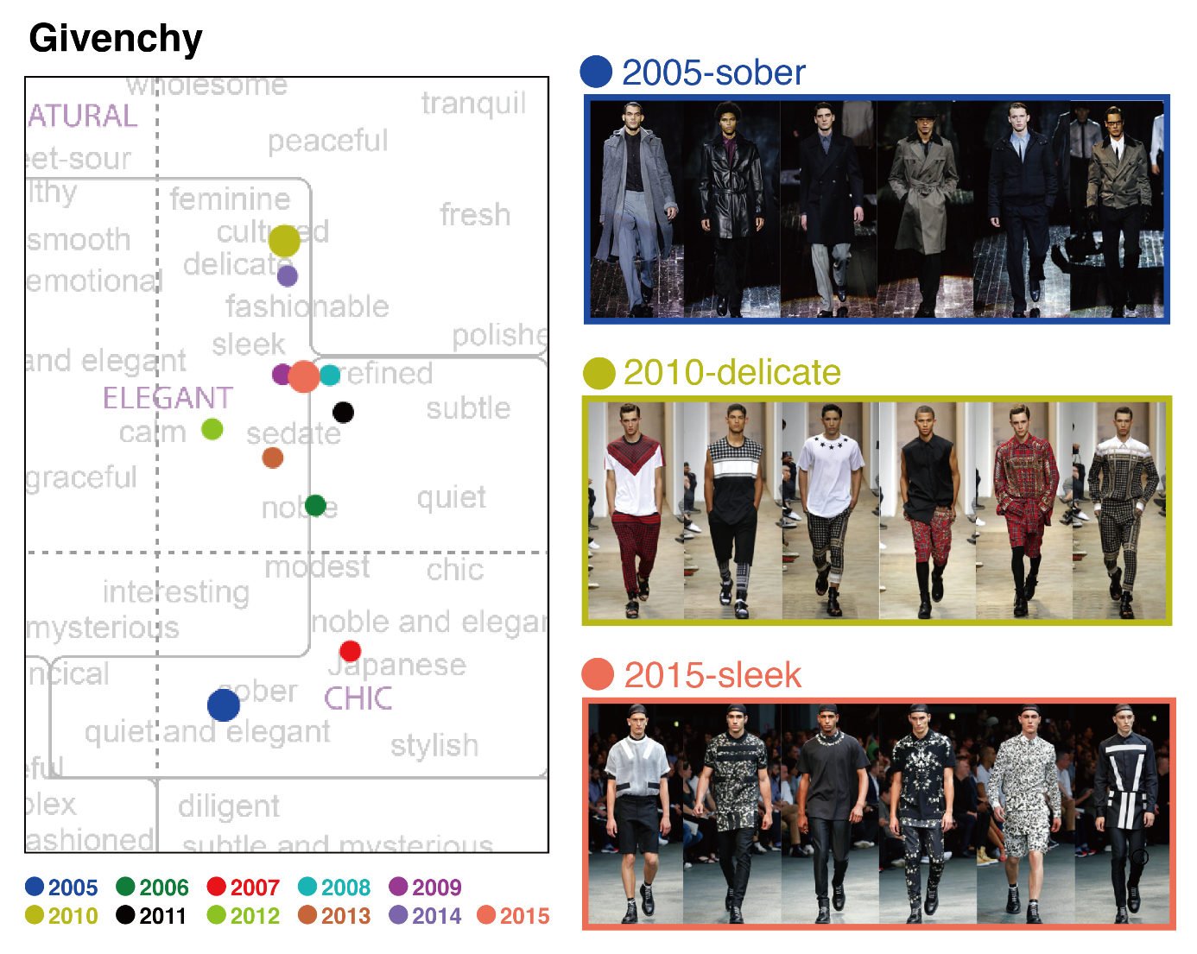
Towards Better Understanding the Clothing Fashion Styles: A Multimodal Deep Learning Approach
Yihui Ma, Jia Jia, etc., Towards Better Understanding the Clothing Fashion Styles: A Multimodal Deep Learning Approach, AAAI 2017

Slide 10
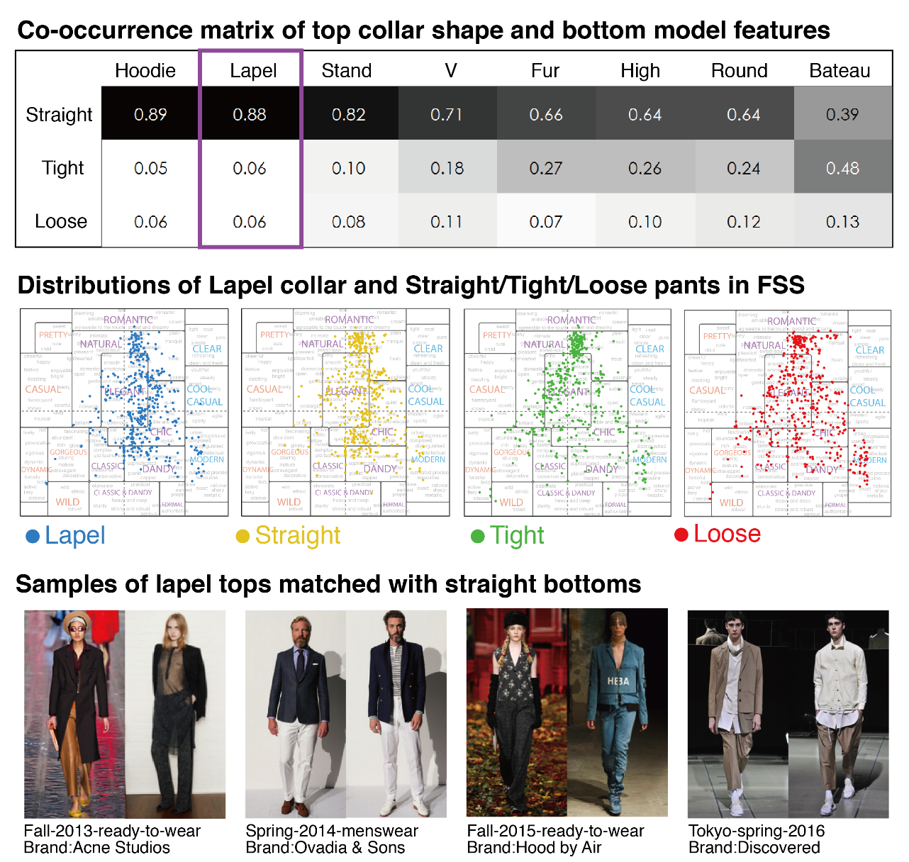
Towards Better Understanding the Clothing Fashion Styles: A Multimodal Deep Learning Approach
Yihui Ma, Jia Jia, etc., Towards Better Understanding the Clothing Fashion Styles: A Multimodal Deep Learning Approach, AAAI 2017

Slide 11
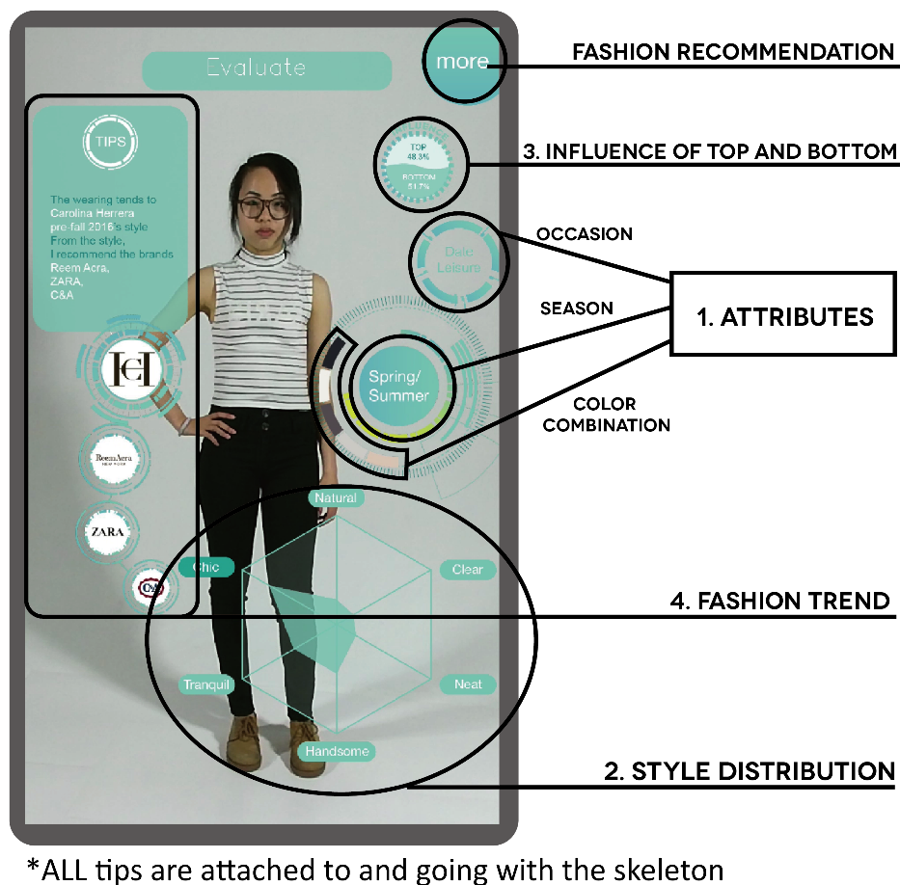
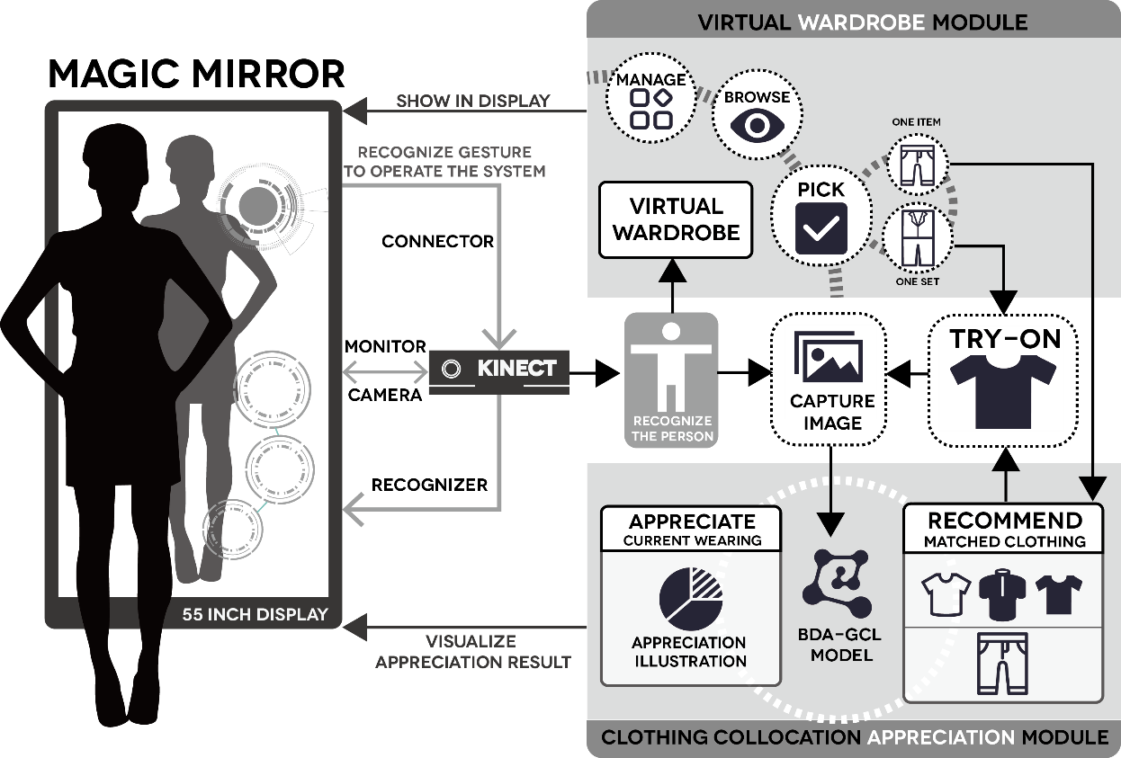
Application : Magic Mirror
Yejun Liu, Jia Jia, etc. Magic Mirror: A Virtual Fashion Consultant. ACM Multimedia, 2016

Slide 12
Towards Better Understanding the Clothing Fashion Styles: A Multimodal Deep Learning Approach Experiment 2
Yihui Ma
2018.08.02

Slide 13
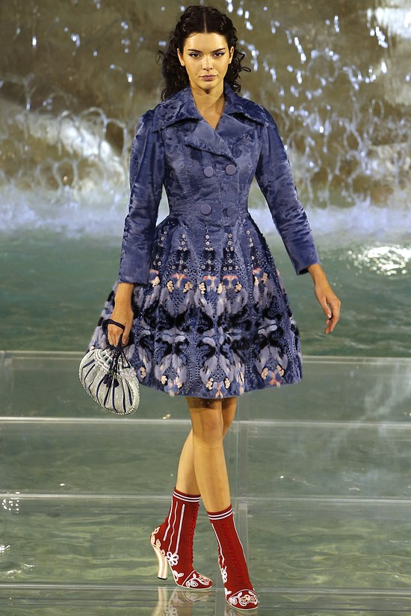
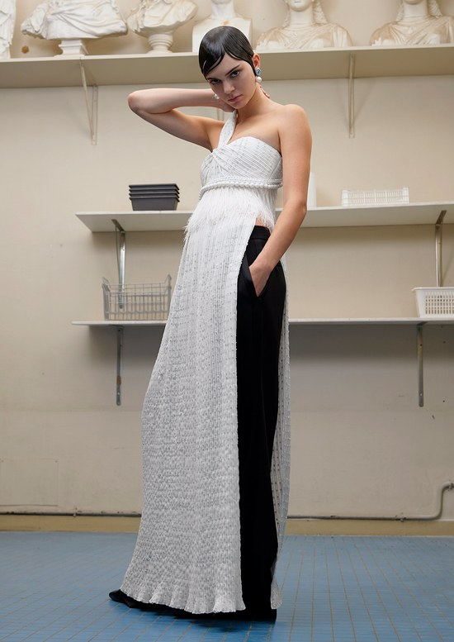
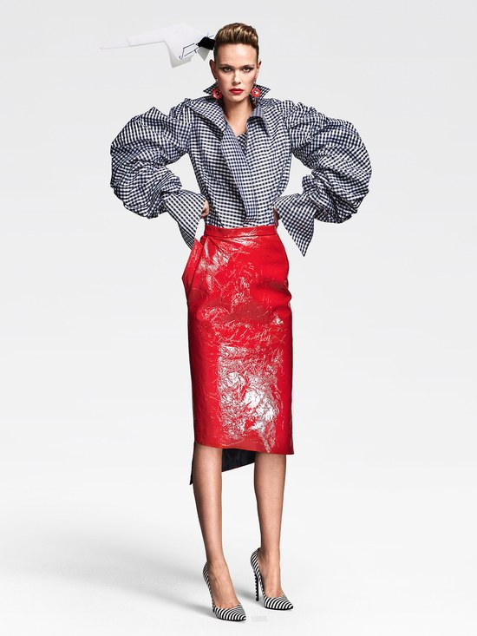
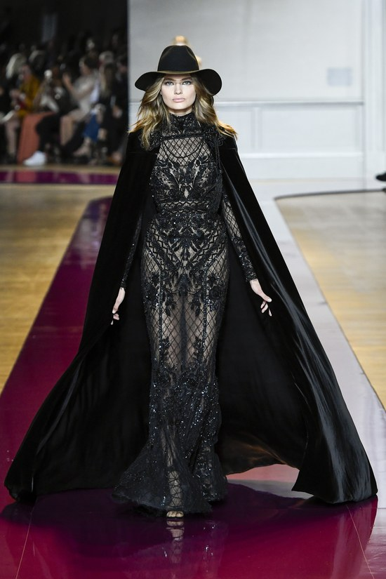
Motivation
What are the most popular clothing fashion styles of this season?
Romantic, elegant, classic. (Fall 2016 Couture collection)

Slide 14
Motivation
People often use aesthetic words to describe the clothing fashion styles, which rely heavily on some visual details such as color combination, collar shape, sleeve length, pattern design, etc.
Different collocations of top and bottom clothing can lead to very different aesthetic styles.
Can we bridge the gap between visual details and fashion styles of clothing collocations automatically? Can we teach computers to appreciate clothing like human beings?
Use deep learning model to solve it!

Slide 15
Fashion Semantic Space
We build a universal Fashion Semantic Space (FSS) to describe clothing fashion styles quantitatively.
It is a two-dimensional image-scale space containing hundreds of words that people often use to describe clothing on shopping websites.
Based on the FSS, we can not only do quantitative evaluation on clothing collocations, but also analyze the dynamic change of fashion trends intuitively.

Slide 16
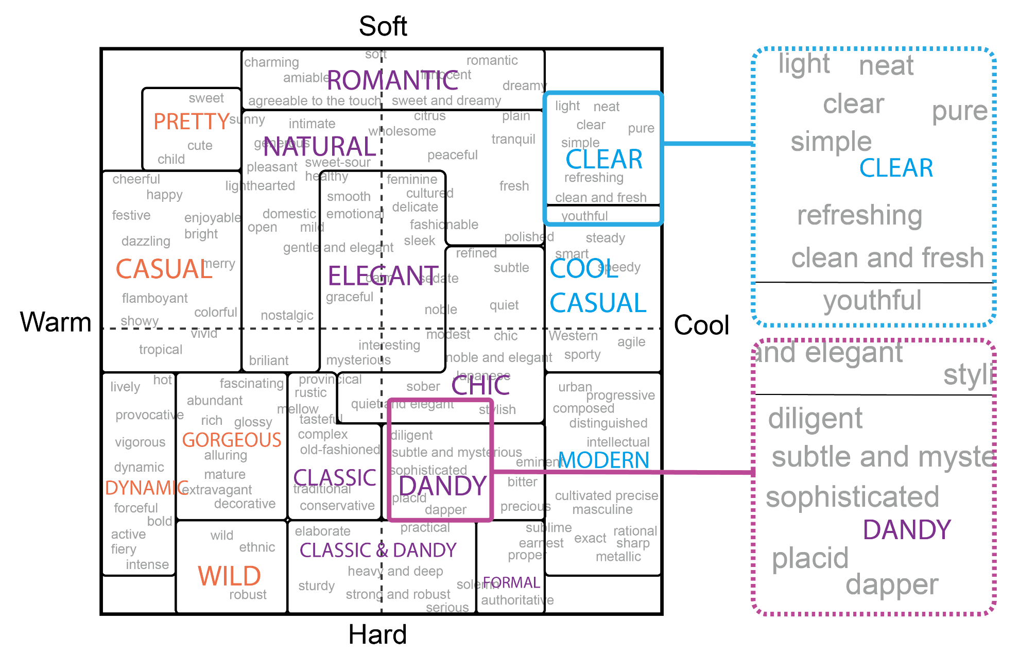
Fashion Semantic Space

Slide 17
Fashion Semantic Space (Details)
For art design, a Japanese color psychologist named Kobayashi proposed 180 keywords in 16 aesthetic categories and defined their coordinate values in the image-scale space.
In order to describe the fashion styles of various clothing, we first observe all the comments in the last three years from the clothing section of Amazon and split them by words.
Then using WordNet, only adjectives are retained.
Next, we manually remove those not often used to describe clothing, like “happy” or “sad”, getting 527 aesthetic words representing fashion styles.

Slide 18
Fashion Semantic Space (Details)
To determine the coordinates of these words, we calculate the semantic distances between keywords and aesthetic words using WordNet::Similarity.
For a word to be coordinated, we choose three keywords with the shortest distances, the weighted arithmetic mean of which can be regarded as the coordinate value.
In this way, we build the Fashion Semantic Space.

Slide 19
Dataset Construction
We build a large full-annotated benchmark dataset, which employs 32133 full-body fashion show images in the last 10 years downloaded from Vogue. It covers both men and women clothing, and contains 550 fashion brands.
The collected dataset is labeled with complete visual features (e.g. collar shape, pants length, color theme, etc.) and fashion styles (e.g. casual, chic, elegant, etc.).

Slide 20
Dataset Construction (Details)
Clothing visual features.
We define the visual features of clothing from two aspects: color features and pattern features.
For the color features, we extract five color theme of clothing images adopting the algorithm proposed by (Wang et al. 2013).
For the pattern features, we invite people to annotate them, and the annotation details are listed in a feature table, in which the “type” feature corresponds to the clothing category in our algorithm.

Slide 21
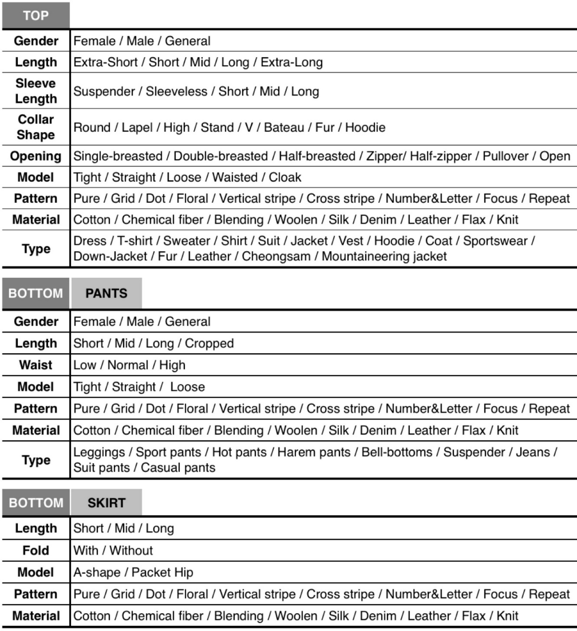
Dataset Construction (Details)
Annotation feature table.
9 kinds of top features.
12 kinds of bottom features, including pants and skirt features.

Slide 22
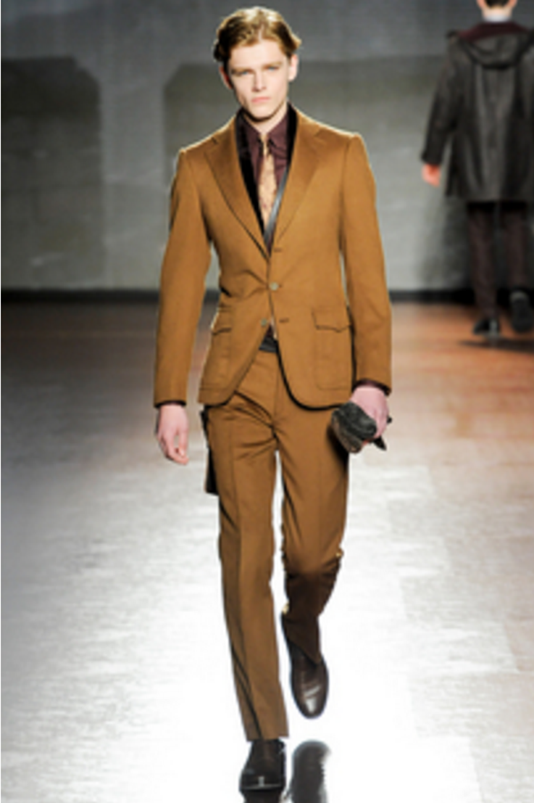
Dataset Construction (Details)
An example.
← V-shaped collar
← Single-breasted
← Straight leg
← Long

Slide 23
Dataset Construction (Details)
Fashion style feature.
For the annotation of fashion styles, we provide the FSS for the annotators, who are well trained with our annotation tool.
For each image, they choose a style section in FSS at first, and then determine a specific coordinate for the image according to the distribution of fashion style words.
For coordinates in the FSS, both warm-cool and soft-hard coordinate values range in [-1, +1] and the granularity of each dimension is 0.001.

Slide 24
Dataset Construction (Details)
For all the annotation features above, 20 annotators (10 males and 10 females) are invited to finish the annotation task.
To guarantee the reliability of annotated features, we require every annotator to achieve the relative accuracy of 95% on every annotation task.
Each attribute of each image is annotated by 3 different annotators, and the final results are voted or averaged by the original 3 results.

Slide 25
Bimodal Correlative Deep Autoencoder
We propose a fashion-oriented multimodal deep learning based model, Bimodal Correlative Deep Autoencoder (BCDA), connected with regression models to implement the task of mapping visual features to FSS.
Specifically, leveraging the shared representation learned by the multimodal strategy, BCDA can make full use of the internal correlation between tops and bottoms, and resolve the issue of clothing collocation.

Slide 26
Bimodal Correlative Deep Autoencoder (Details)
Although the traditional Deep Autoencoder (DA) is an approach to feature learning, it cannot make use of the internal correlation between top and bottom clothing. Thus we take two strategies to resolve this issue:
1) We adopt a multimodal deep learning model, Bimodal Deep Autoencoder (BDA), and adapt it for fashion-oriented feature learning. Regarding tops and bottoms as two modals of clothing collocations, the shared representation learned from BDA can be regarded as the new feature representation, which serves as the input of the regression model.

Slide 27
Bimodal Correlative Deep Autoencoder (Details)
2) It is observed that for different categories (e.g. suit, coat, leggings, etc.), even clothing images with similar visual features can present different fashion effects, showing that fashion styles are influenced by clothing categories. So we take clothing categories as correlative labels, and promote the BDA to a novel structure named Bimodal Correlative Deep Autoencoder (BCDA).

Slide 28
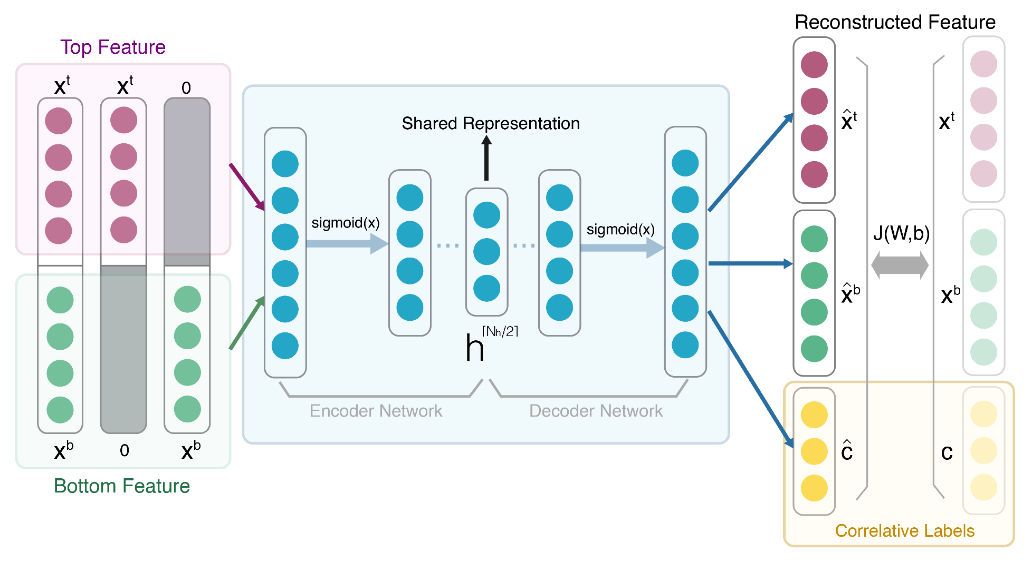
Bimodal Correlative Deep Autoencoder (Details)
The structure of BCDA.

Slide 29
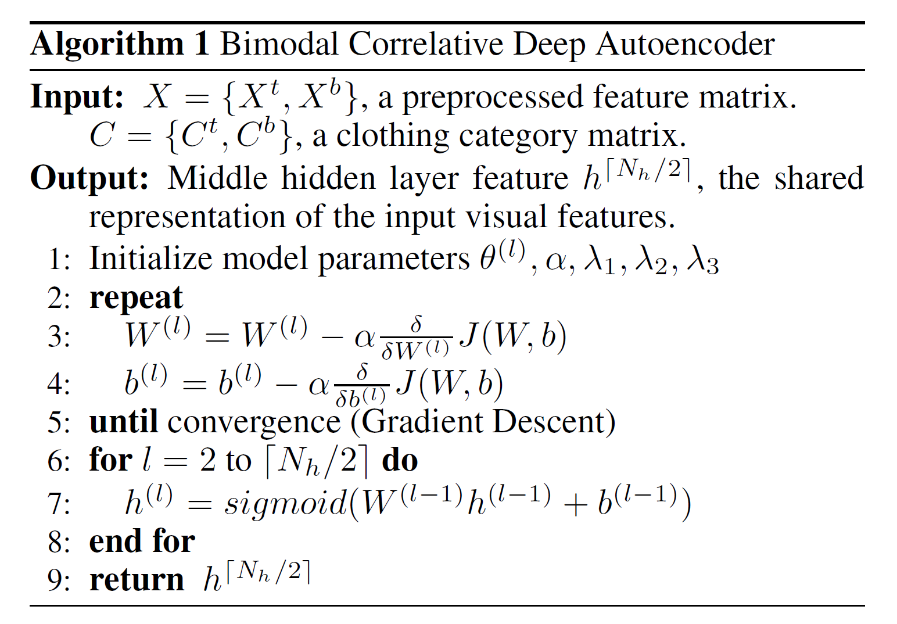
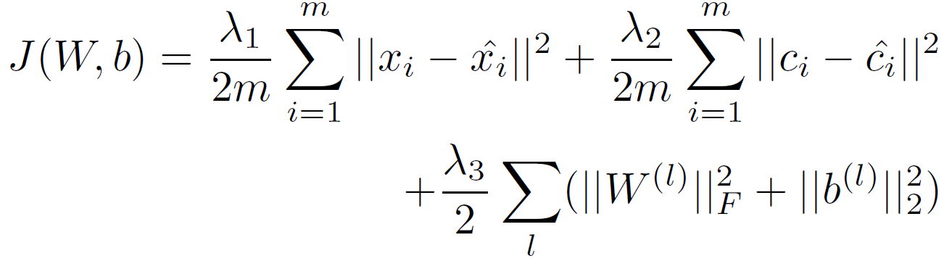
Bimodal Correlative Deep Autoencoder (Details)
Algorithm details of BCDA.
Cost function:
The optimization method we adopt is Stochastic Gradient Descent Algorithm.

Slide 30
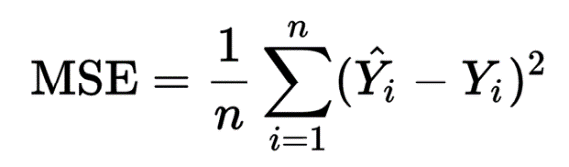
Experiments
Metric
To evaluate the mapping effects between visual features and coordinate values in FSS, we calculate the error between predicted coordinate values and annotated coordinate values.
The error is measured by mean squared error (MSE).
All the experiments are performed on 5-folder cross-validation.

Slide 31
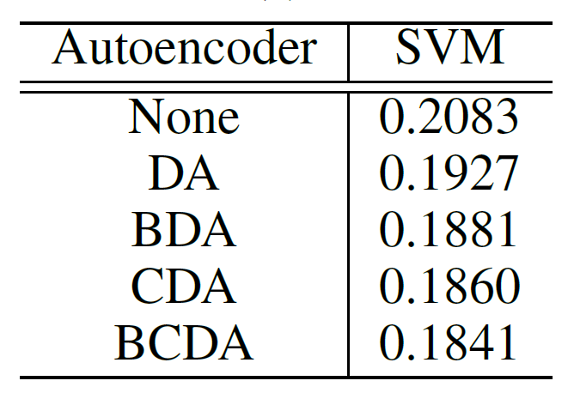
Experiments
Performance of different autoencoders.
Using the same regression model Support Vector Machine (SVM), we compare the proposed BCDA with other different autoencoder settings.
The bimodal strategy (with/without “B”) takes effect, which indicates that top and bottom do have a correlation at feature level.
The correlative-label strategy (with/without “C”) contributes to the result too, proving that clothing categories have impact on fashion styles indeed.

Slide 32
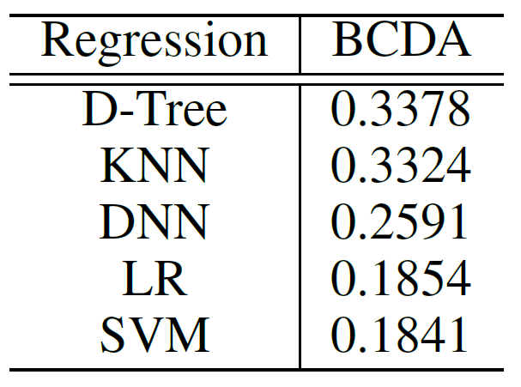
Experiments
Performance of different regression models.
Using the proposed BCDA, we also make several comparisons among different regression models including Decision Tree (D-Tree), K-Nearest Neighbors (KNN), Deep Neural Network (DNN), Linear Regression (LR), and Support Vector Machine (SVM).
D-Tree and KNN have the worst performance, while LR and SVM prove to be effective regression models in our task.
In the following experiments and demonstrations, we take the best performing SVM as the regression model.

Slide 33
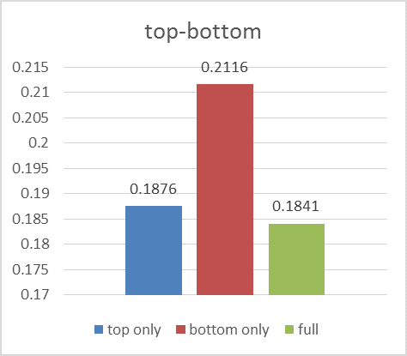
Experiments
Contribution of top and bottom features.
Top features contribute more than bottom features, which is in accordance with our ordinary feelings that tops count more in clothing collocation.

Slide 34
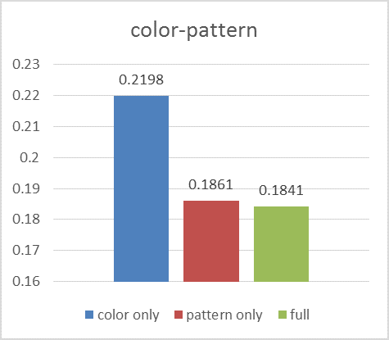
Experiments
Contribution of color and pattern features.
It shows that pattern features perform better than color features, probably because patterns' combination has more influence on fashion collocations.

Slide 35
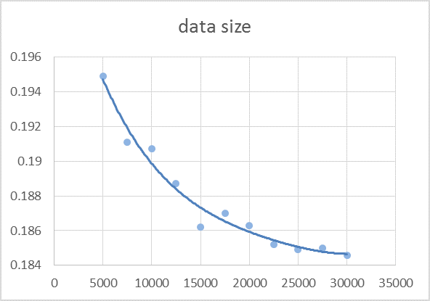
Experiments
Training data size analyses.
We can find that as the scale of training data increases the performance gets better.
With the size over 25000, the performance almost reaches convergence.
Therefore, the size of our whole dataset (32133) is a proper number.

Slide 36
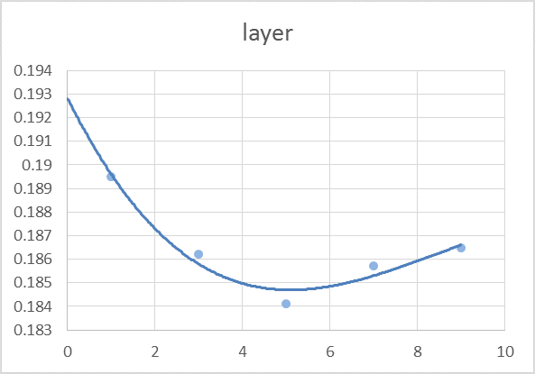
Experiments
Hidden layer number analyses.
Theoretically, the description ability of BCDA can be improved by adding more layers.
According to the figure, the performance do increase with layer number less than 5, but get worse after the number become larger because of overfitting.
Therefore, we take 5 layers in our experiments.

Slide 37
Task
Data files
fashion_train.csv: training data, 25706 rows * 139 cols
fashion_test.csv: test data, 6427 rows * 139 cols
feature_table.xlsx: definitions of every feature column
Data format
Data have been randomly split into 4:1 ratio of training and test set
The first 137 columns represent clothing visual features (Input)
The last 2 columns represent fashion style feature (i.e. 2-dimendional coordinates on the Fashion Semantic Space) (Output)

Slide 38
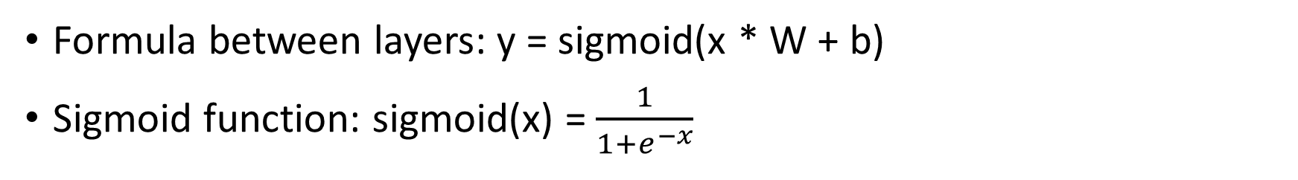
Task
Step 1: Use original features to train a 5-layer autoencoder
encoder_w1
encoder_w2
decoder_w2
decoder_w1
x_input
(original features)
x_output
(as close to x_input as possible)
encoder_b1
encoder_b2
decoder_b2
decoder_b1
Formula between layers: y = sigmoid(x * W + b)
Sigmoid function: sigmoid(x) = $\frac{1}{1+e^{−x}}$

Slide 39
Task
Step 2: Calculate middle layer representation of original features
encoder_w1
encoder_w2
x_input
(original features)
x_input_new
_representation
(middle layer output)
encoder_b1
encoder_b2
encoder_w1, encoder_b1, encoder_w2, encoder_b2 are well-trained parameters during the last step

Slide 40
Task
Step 3: Use new representation of features to train DNN regressor
DNN
regressor_1
x-coordinate on FSS
(i.e. 138th column of original data)
x_input_new
_representation
(middle layer output)
y-coordinate on FSS
(i.e. 139th column of original data)
DNN
regressor_2
Metric: the sum of two DNN regressors’ MSE loss

Slide 41
Task
# TODO : 1. Create weights and biases of encoder's second layer. (5%)
# TODO : 2. Create weights and biases of encoder's *second* layer. (5%)
# TODO : 3. Write the computation of encoder's second layer and decoder's *second* layer. (5%)
# TODO : 4. Define the loss function. (5%)
# TODO : 5. Define a gradient descent optimizer. (5%)

Slide 42
Task
# TODO : 6. Change train_features and test_features from numpy arrays to tensorflow constants. (5%)
# TODO : 7. Calculate the middle layer representation of train/test features. (10%)
# TODO : 8. Define DNN regressor. (5%)
# TODO : 9. Train the regressor. (5%)
# TODO : 10. Evaluate the loss on test set. (5%)

Slide 43
Thanks! Q&A
/home/share/dlss_exp
https://git.net9.org/OneSida/dlss_exp

